Slide 2
Definition:
The Observer Pattern defines a one to many dependency between objects so that one object changes state, all of its dependents are notified and updated automatically.

Slide 3
Explanation:
One to many dependency is between Subject(One) and Observer(Many).
There is dependency as Observers themselves don’t have access to data. They are dependent on Subject to provide them data.

Slide 4
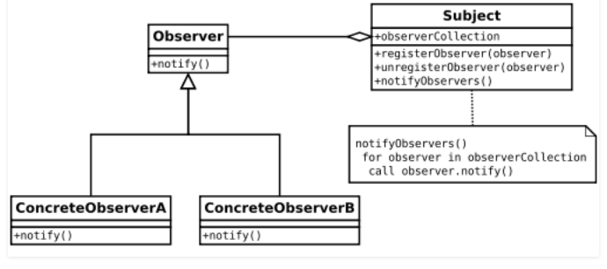
Class diagram:

Slide 5
Here Observer and Subject are interfaces(can be any abstract super type not necessarily java interface).
All observers who need the data need to implement observer interface.
notify() method in observer interface defines the action to be taken when the subject provides it data.

Slide 6
The subject maintains an observerCollection which is simply the list of currently registered(subscribed) observers.
registerObserver(observer) and unregisterObserver(observer) are methods to add and remove observers respectively.
notifyObservers() is called when the data is changed and the observers need to be supplied with new data.

Slide 7
When to use this pattern? You should consider using this pattern in your application when multiple objects are dependent on the state of one object as it provides a neat and well tested design for the same.
Real Life Uses:
It is heavily used in GUI toolkits and event listener. In java the button(subject) and onClickListener(observer) are modelled with observer pattern.
Social media, RSS feeds, email subscription in which you have the option to follow or subscribe and you receive latest notification.
All users of an app on play store gets notified if there is an update.

Slide 8
Example
we are building a cricket app that notifies viewers about the information such as current score, run rate etc. Suppose we have made two display elements CurrentScoreDisplay and AverageScoreDisplay. CricketData has all the data (runs, bowls etc.) and whenever data changes the display elements are notified with new data and they display the latest data accordingly.

